Slide 3
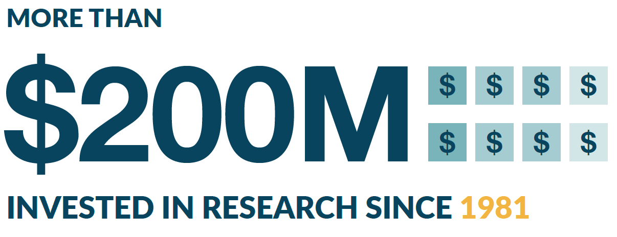
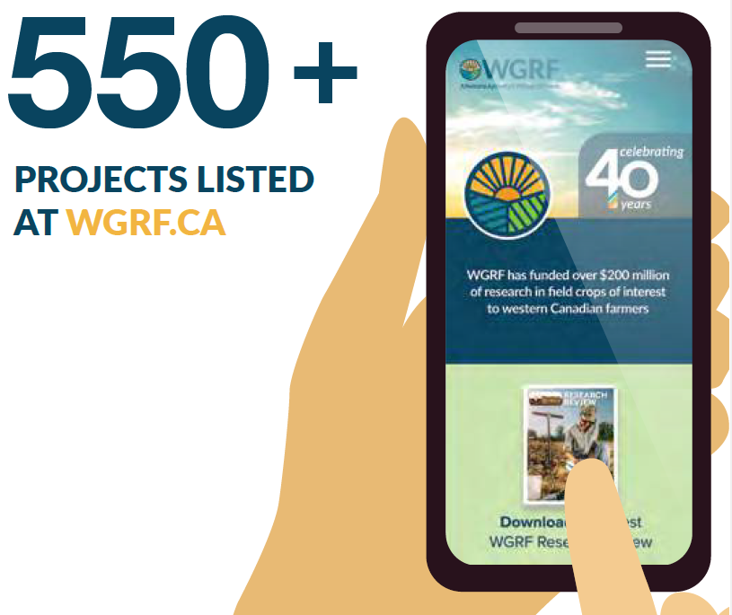
Over 40 Years

Slide 4
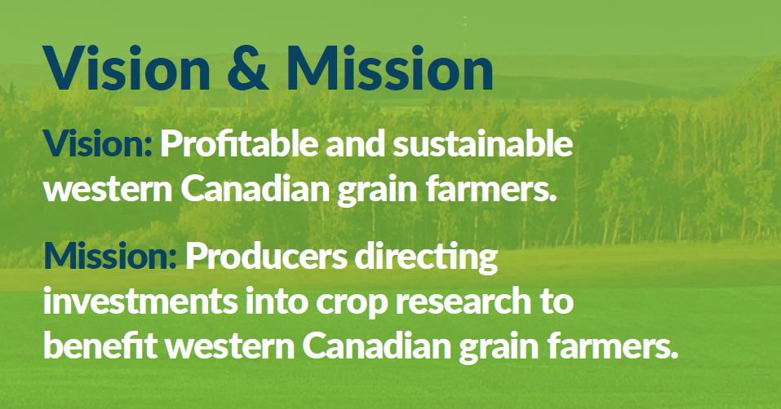

Slide 5
New Look

Slide 6
Overview
Federally registered not-for-profit
Charitable status
Board of Directors = 18 farmers
Research focus
$14M annual average funding (5 yr)
172 projects, 15 crops, 5 clusters
$53M research funding next four years

Slide 7
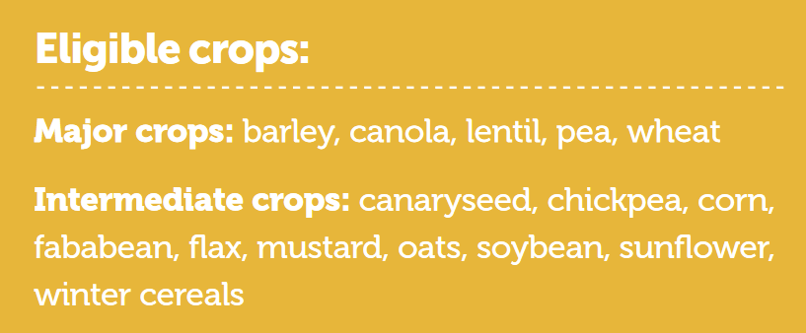
Crops of Interest

Slide 8
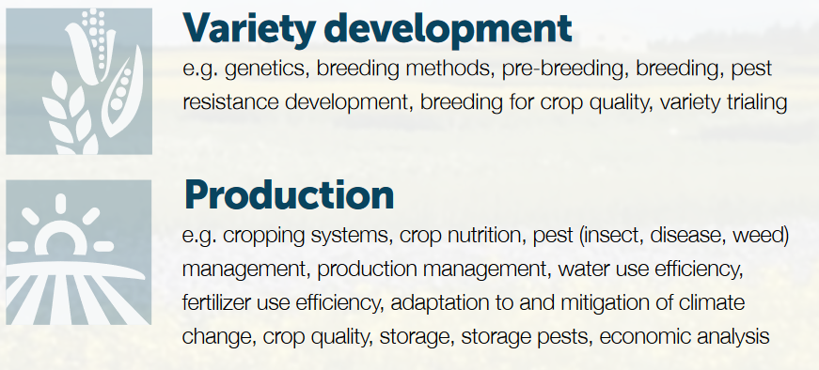
Priority Areas

Slide 9
Funding Process
Participate in established, science-based competitive processes consistent with WGRF research priorities
WGRF does not accept research proposals directly

Slide 10
Funding Process
Researchers interested in accessing WGRF funding can submit proposals to:
- Agriculture Development Fund (ADF) - SK
- Ag Action Manitoba (AAM) - MB
- Agriculture Funding Consortium (AFC) – AB
- Canola Agronomic Research Program (CARP)

Slide 11
Funding Process
Involved with other programs
- CAP (Clusters, Projects)
- Genome Canada
- NSERC
Collaborate with other funders
- Crop commissions
- Governments

Slide 12
Funding Process
WGRF Research Committee makes recommendations to Board:
- Benefit to farmers
- Science
- Likelihood of success
Board makes funding decisions
Staff manage process and implement decisions

Slide 13
Congratulations! Your Proposal is Approved
WGRF Funding: up to 100%
Contract required
Annual reporting and payment schedule
Flexibility (payment schedule)
Changes require contract amendment

Slide 14
Research Chair in Cropping Systems
(Dr. Linda Gorim)
Systems/Integrated Agronomy Chair
(Dr. Maryse Bourgault)
Two Research Chairs
(Dr. Mario Tenuta, 4R Nutrient Stewardship and TBD)

Slide 15
Phase 2 launched in April 2019
$24 M approved for research capacity (equipment & infrastructure)
valargurusamy@wgrf.ca

Slide 16
$300,000/yr Graduate Scholarships

Slide 17
Sponsorship

Slide 18
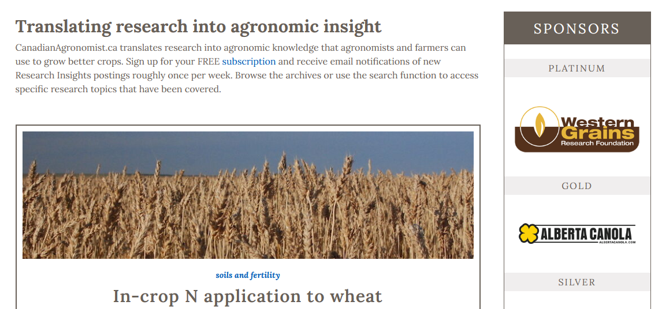
WGRF Over 40 Years

Slide 19
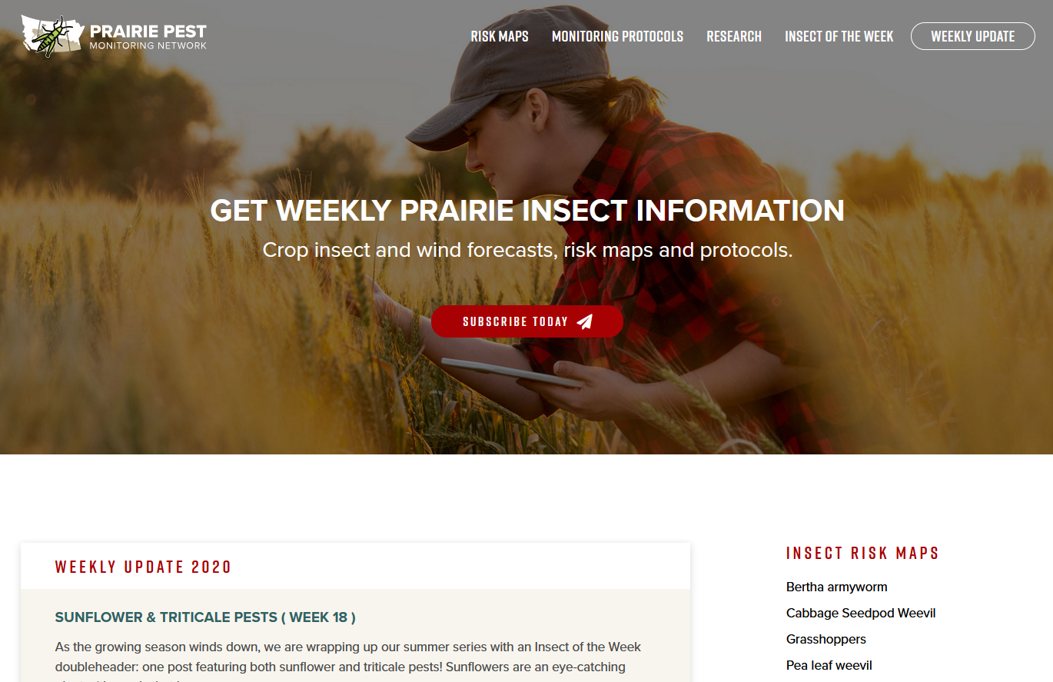
WGRF Over 40 Years

Slide 21
Summary: Accessing WGRF Funds
WGRF funding interests
- 15 crops
- Variety development and production
- Single and multi-crop issues

Slide 22
Summary: Accessing WGRF Funds
Science based competitive processes
Independent decision making and funding
Benefit to farmers
Think Western Canadian!
Remember technology transfer

Slide 23
For more information please contact:
Lisa Jategaonkar M.Sc. Research Program Manager (306) 975-0099 LisaJategaonkar@wgrf.ca | Pat Flaten, M.Sc., PAg Research Program Manager (306) 975-0207 PatFlaten@wgrf.ca
Joelle Harris, B.S.A., PAg Research Program Manager (306) 975-1230 JoelleHarris@wgrf.ca | Valar Gurusamy, Ph.D., AAg Research Program Manager (306) 975-1232 Valargurusamy@wgrf.ca

Slide 24
Thank you

